Slide 1
8th November 2023
In partnership with
And thanks to
@BIMA
@BIMA
@bima_hq_
BIMA.co.uk | #DigitalDay23

Slide 2
We are:
Notes:
In this section, please include more about who you are, what you specialise in, some of the clients you work with, some of the work you have done and any other fun facts about your company. Please include an agency/company showreel or video of applicable (please keep this to a maximum of two minutes).

Slide 3
What we do:
(NB. This is your space to tell people who you are, see notes below.)
SLIDE FOR AGENCIES/COMPANIES ONLY
In this section, please include more about who you are, what you specialise in, some of the clients you work with, some of the work you have done and any other fun facts about your company. Please include an agency/company showreel or video of applicable (please keep this to a maximum of two minutes).
BIMA.co.uk | #DigitalDay23

Slide 4
WHAT IS DIGITAL?
Notes:
To make this part more interactive, you can pose the questions to the students – ask them for their own examples of Digital

Slide 5
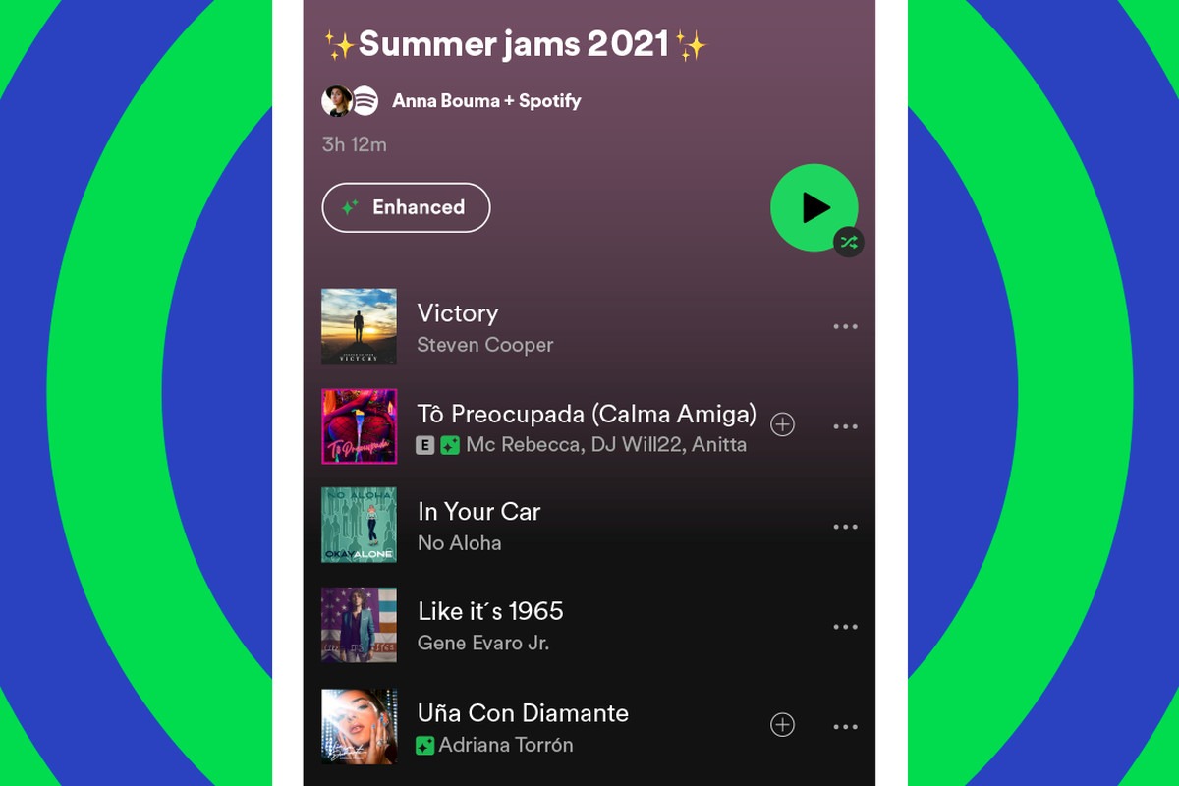
What’s Digital?
Notes:
Let’s start off with understanding what we mean by “digital”.
Add the more obvious examples here – TikTok and social media…Netflix, gaming, Spotify etc

Slide 6
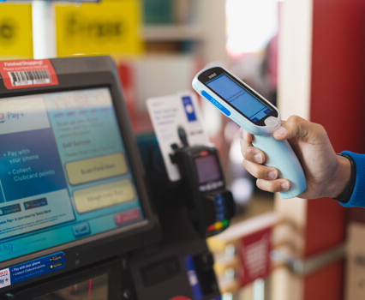
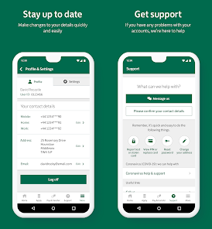
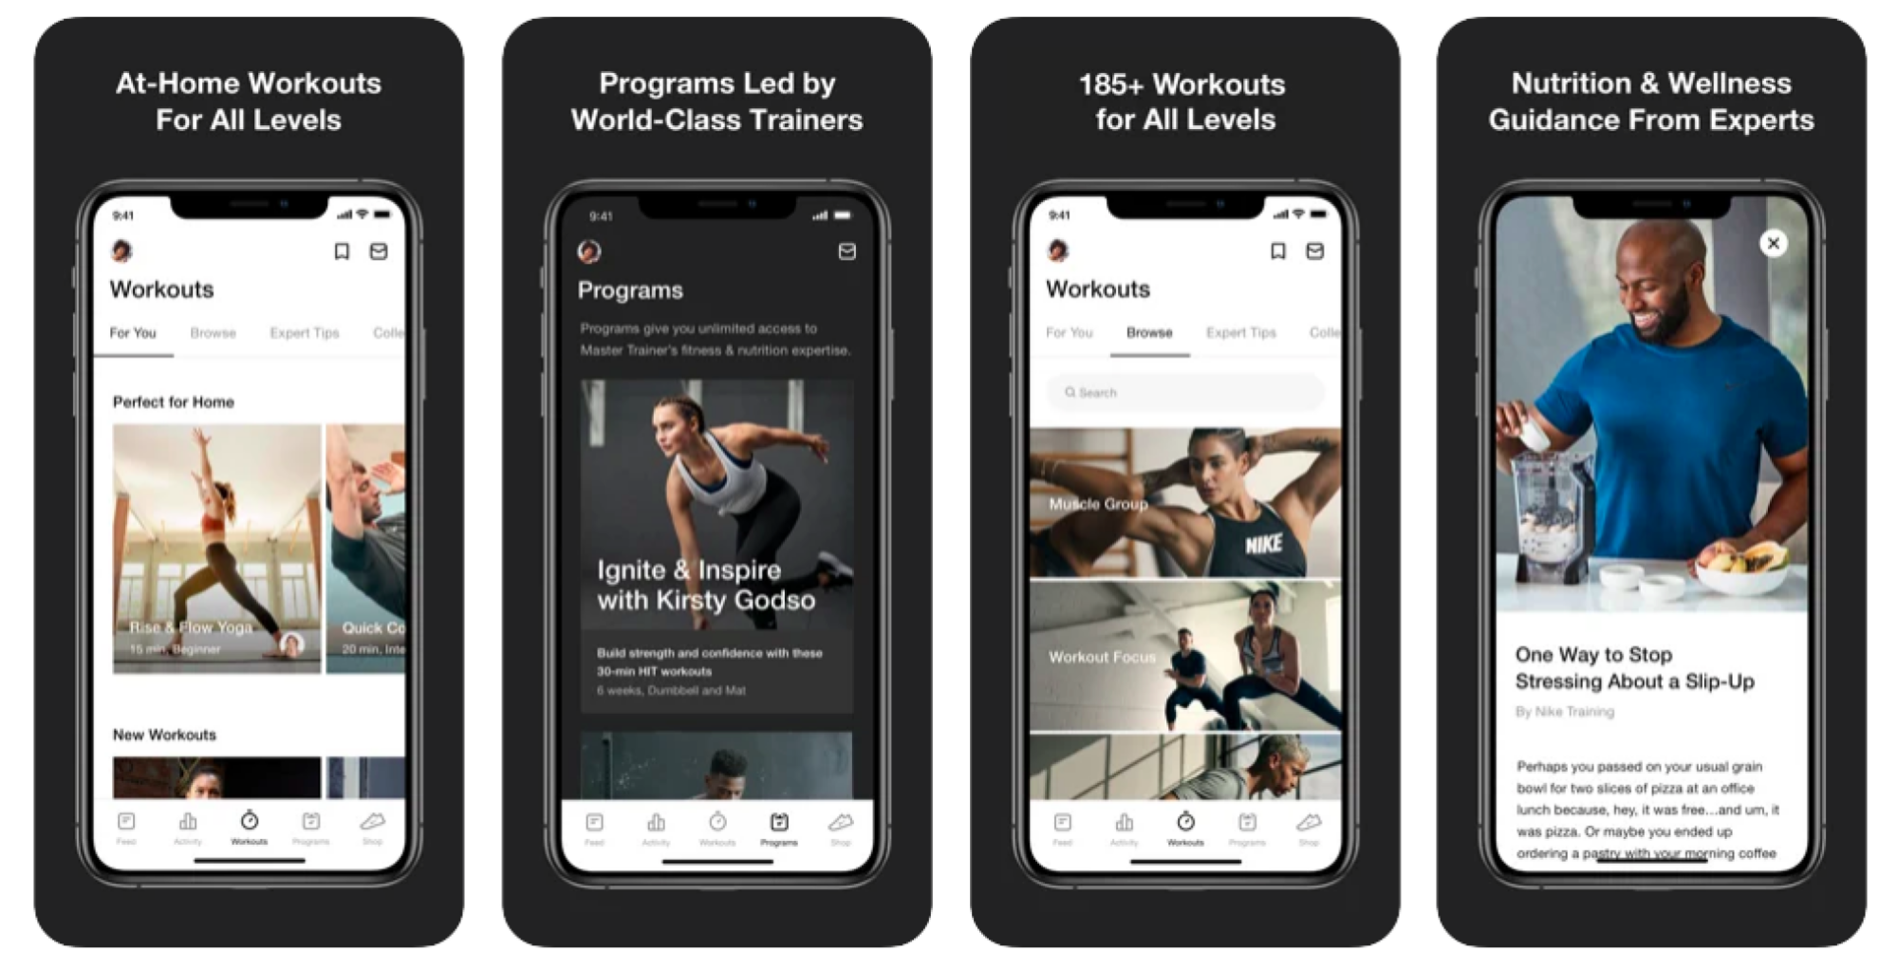
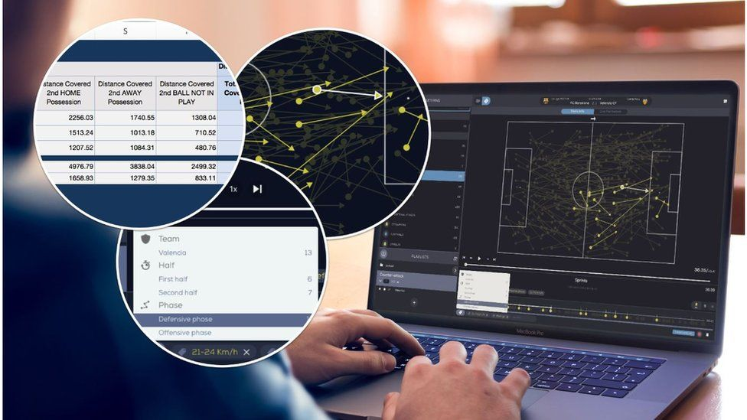
It’s also here…
Notes:
Add examples of more discreet everyday use of digital. Banking, navigation, scanner in supermarkets, data analysis on football matches, health and wellness apps

Slide 7
THE DIGITAL INDUSTRY https://vimeo.com/371350787

Slide 8
Today YOU are the digital agency…
The role of agencies and clients
Getting a client brief
Our process to solve the brief is…
Notes:
Explain how client do not have everything inhouse and rely a lot on specialist agencies as and when they need them.
Explain that today they are going to be a digital agency! A classroom full of developers, designer and strategists.
And two big clients have sent us briefs to solve for them…

Slide 9
OUR 3 STEPS TO SOLVING A BRIEF:
1. Discover
2. Design
3. Deliver

Slide 10
This year we have one challenge brief. Thanks to our challenge partner:

Slide 11
Vue - What’s the story?
Vue Entertainment is one of the biggest entertainment providers within the UK and Ireland, with 91 state-of-the-art cinemas, over 870 screens and more than 150,000 seats.
We’re committed to delivering the ‘big screen’ experience and offer a diverse range of content in our venues, from the most highly-anticipated blockbusters, to live-streamed sporting events and concerts, and event cinema screenings covering opera, ballet, and theatre.
In a post-pandemic world – where cinema was one of many entertainment and leisure providers forced to close – and in the midst of a cost-of-living crisis – where people are having to make more considered choices about where they spend their money – we know that cinema might not always be the number one choice of leisure activity.
And with the rise of streaming services, we know that young people especially may be less likely to choose cinema. So that’s where you come in – what would make YOU choose cinema over another leisure activity?

Slide 12
What’s the challenge?
How can we use technology and digital solutions to incentivise more young people to choose cinema over other entertainment sources?
What do I need to think about?
Customers can go directly into one of our 91 cinemas to book their tickets, but they can also use our website (www.myvue.com) or our app. Roughly two-thirds of our customers book their cinema tickets online, with the majority of those customers preferring to book their tickets on our website via their mobile phones. Although fewer customers use the app to book their tickets, the customers who do use the app are our most loyal: they are most likely to return to Vue again and again to watch films with us.
We communicate with our customers by email, push notifications, and our social media channels, and advertise on Facebook, Instagram, Google, YouTube, and TikTok, as well as in non-digital channels such as radio, newspapers, billboards, and more.

Slide 13
Here’s some questions to get you thinking…
How can Vue use technology and digital solutions to get young people excited about a trip to the cinema?
What ways can we build out immersive experiences using technology to attract more young people?
What helps you decide between cinema and other types of entertainment? Is it the cost? Convenience?
How do you connect with friends? How can this be used to create communities around movies?
What do you think will grab young people’s attention?
Considerations:
Be inclusive: Many of our customers are comfortable using and interacting with technology, but there are others who aren’t. How can we make our technology more usable for everyone and explore additional solutions? For example, consider those with disabilities, low-income backgrounds, and non-native English speakers etc.
Be practical: is this something we could easily launch into our business?
Be creative: Think about the whole cinema experience, from ordering tickets through to ordering food in the venue. What about if you had to report unsociable behaviour? Think about every aspect of a cinema visit and use that to help you think about the kind of digital solutions that could make the experience better.

Slide 14
TIME FOR A BREAK

Slide 15
LET’S TACKLE THAT BRIEF!

Slide 16
OUR 3 STEPS TO SOLVING A BRIEF:
1. Discover
2. Design
3. Deliver
Notes:
Information here on the strategic approach.

Slide 17
STEP 1: DISCOVER
In order to discover, you need to explore.
Notes:
Introduce the students to the first element of designing a product – Discovery!
You have 10 minutes to brief students and then 35 minutes for them to work on this section.
Remember to give them a 15 minute warning at the end to make sure they have agreed on an idea (last slide in this section)

Slide 18
STEP 1: DISCOVER
WHAT ARE WE LOOKING FOR?
In the first part of the challenge, we want to see the thought process behind your idea and where it came from. Here are a few suggestions of ways to get you thinking about an idea:
EXPLORE THE RELEVANT MARKET
What information can you find out about Vue and what they are currently doing?
What are their competitors doing? Are they doing anything differently?
What are some of the trends in that industry?
Can you see any gaps in the market?
Who are you selling / communicating to?
What problem areas does your audience face? How could you solve them?
RESEARCH THE AUDIENCE

Slide 19
WHAT IS YOUR IDEA?
AFTER YOUR RESEARCH, TRY AND ARRIVE AT AN IDEA.
WHAT HAVE YOU LEARNT? USE THAT TO COME UP WITH A SOLUTION!
DOES YOUR IDEA EXCITE YOU?
IS THE IDEA ORIGINAL?
WOULD YOU USE THIS PRODUCT?
IS IT DIGITAL?
…AND DOES IT ANSWER THE BRIEF?

Slide 20
15 MINUTES REMAINING

Slide 21
STEP 2: DESIGN
”Design is not just what it looks and feels like. Design is how it works” - Steve Jobs
Notes:
Introduce the students to the second element of designing a product – Design!
You have 10 minutes to brief students and then 35 minutes for them to work on this section.

Slide 22
STEP 2: DESIGN
WHAT ARE WE LOOKING FOR?
This next part is where you bring your idea to life and help us imagine what it will look like and how it will be used. Here are a few pointers to help:
Does your client already have a strong brand, how can you incorporate their colours, logo or slogan?
What features will the product have?
Think about who’ll use this product, how can you make it simple to use?
What technology will you be using? Is it going to be on social, WhatsApp, an app or a website?
Show us how your product will be used, draw out how it will look on an app, social etc.
Where will you promote your product, how are you going to advertise?

Slide 23
CHECK YOUR DESIGN
HOW DOES IT WORK?
DOES THE LOOK OF IT FEEL RIGHT FOR YOUR AUDIENCE AND CLIENT?
DOES YOUR PRODUCT SOLVE THE PROBLEM YOU IDENTIFIED?
IS IT UNIQUE?

Slide 24
15 MINUTES REMAINING

Slide 25
TIME FOR
LUNCH

Slide 26
RECAP…
YOU HAVE 15 MINUTES LEFT TO FINISH YOUR DESIGN.
BEFORE YOU BEGIN, SPEND 5 MINUTES AS A TEAM REVISITING THE TOP 3 THINGS YOU HAVE LEARNT IN DISCOVERY AND CONSIDER WHERE YOU ARE IN THE DESIGN PROCESS.
WITH 15 MINUTES LEFT, WHAT SHOULD YOU PRIORITISE?

Slide 27
STEP 3: DELIVER
Are you ready to pitch your idea?
Notes:
Introduce the students to the third part of the challenge – Deliver!
You have 10 minutes to brief students and then 35 minutes for them to work on this section.
Remember to give them a 15 minute warning at the end to make sure they're ready.

Slide 28
STEP 3: DELIVER
WHAT ARE WE LOOKING FOR?
It’s the final stage and time to prepare for your pitch. Here are a few tips and things to think about to help deliver the perfect pitch:
Remember you’ve only got 5 minutes max to present so make it short and sharp!
Choose who will present
Focus on what makes your product unique
What benefit or value would your idea bring to the people who buy it?
How will your product make the company money?
Explain your idea in simple terms so it’s easy to understand
Could you use anything to help explain your product?
Relax, breathe and most of all - enjoy!

Slide 29
PITCH CHECKLIST
DOES EVERYONE HAVE SOMETHING TO DO/SAY AS PART OF YOUR PRESENTATION?
DO YOU SOUND ENTHUSIASTIC ABOUT YOUR IDEA?
DO YOU KNOW YOUR PRODUCT REALLY WELL?

Slide 30
15 MINUTES REMAINING

Slide 31
TIME TO PRESENT GOOD LUCK!

Slide 32
8th November 2023
In partnership with
And thanks to
@BIMA
@BIMA
@bima_hq_
BIMA.co.uk | #DigitalDay23

