Slide 1
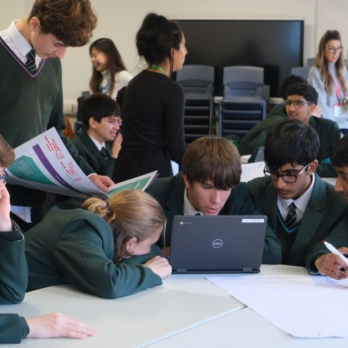







13th November 2024
In partnership with
And thanks to
@BIMA
@BIMA
@bima_hq_
BIMA.co.uk | #DigitalDay24

Slide 2
WELCOME!
@BIMA
@BIMA
@bima_hq_
BIMA.co.uk | #DigitalDay24
Notes:
To make this part more interactive, you can pose the questions to the students – ask them for their own examples of Digital

Slide 3


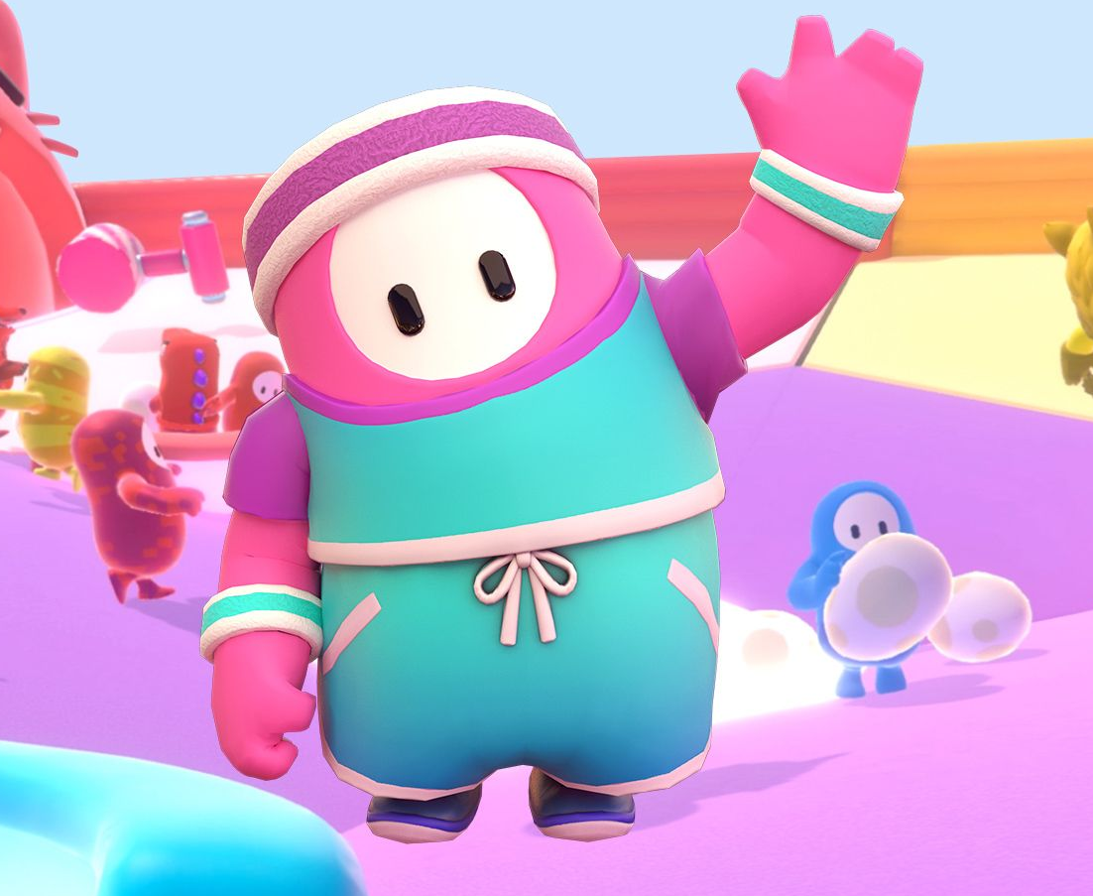
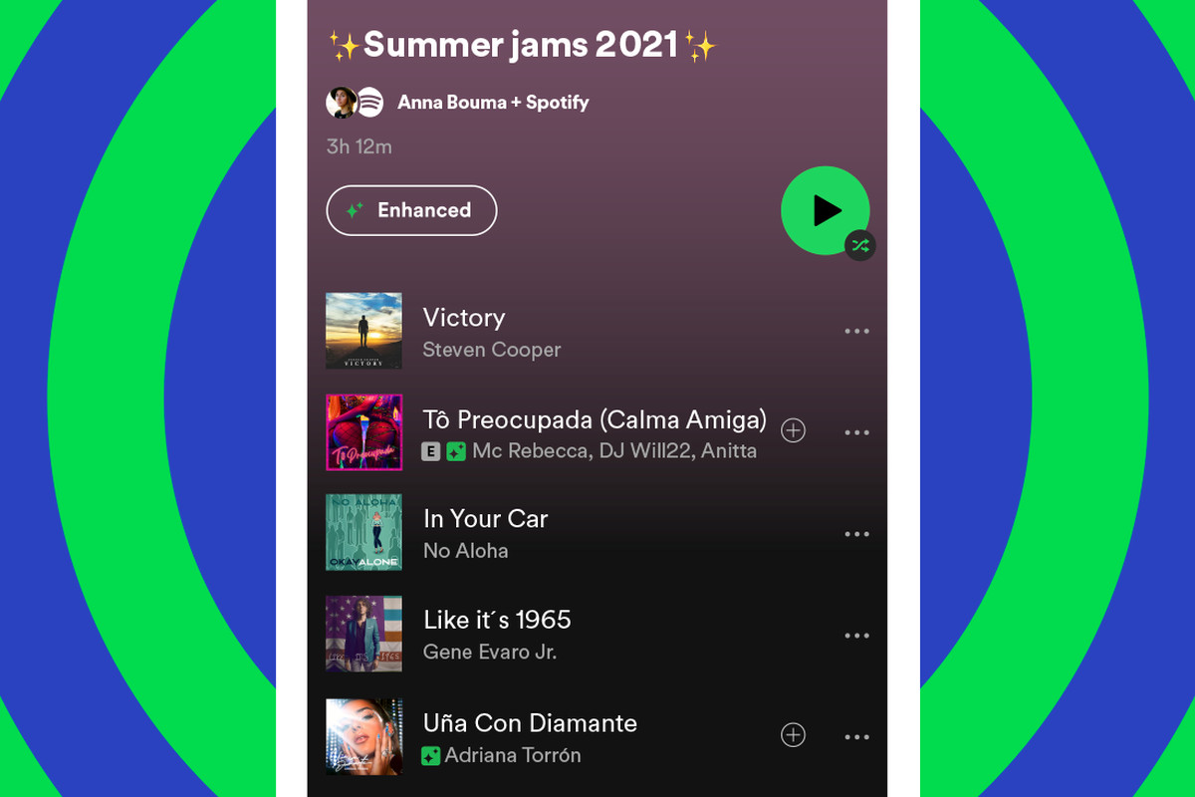
What’s Digital?
Notes:
Let’s start off with understanding what we mean by “digital”.
Add the more obvious examples here – TikTok and social media…Netflix, gaming, Spotify etc

Slide 4
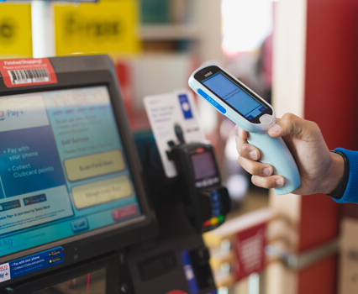
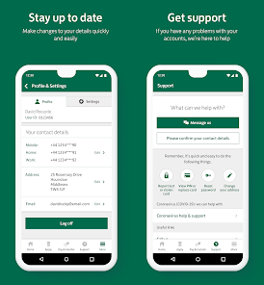
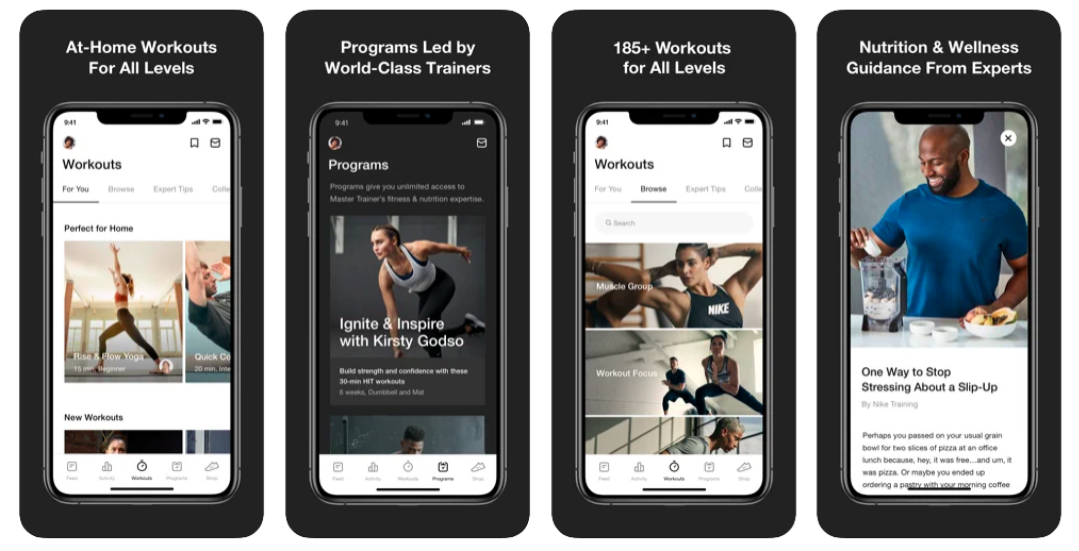
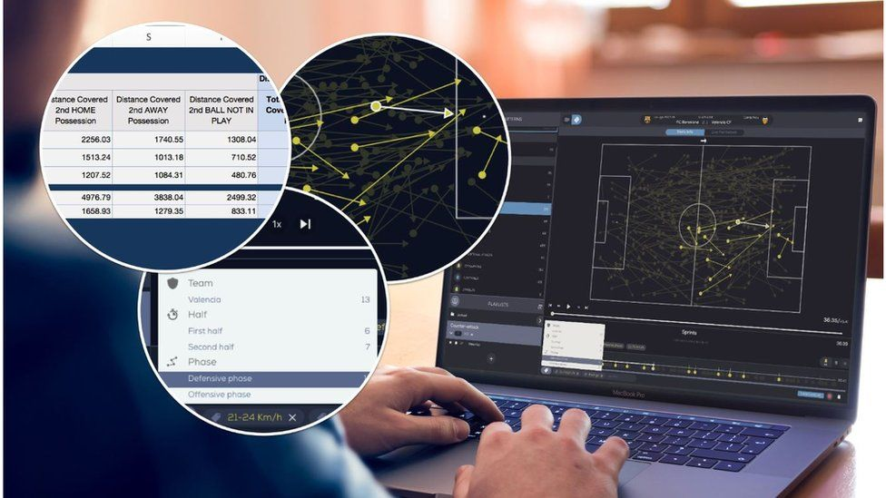
It’s also here…
Notes:
Add examples of more discreet everyday use of digital. Banking, navigation, scanner in supermarkets, data analysis on football matches, health and wellness apps

Slide 5

THE DIGITAL INDUSTRY https://vimeo.com/1024426365

Slide 6
Today YOU are the digital agency…
The role of agencies and clients
Getting a client brief
Our process to solve the brief is…
@BIMA
@BIMA
@bima_hq_
BIMA.co.uk | #DigitalDay24
Notes:
Explain how client do not have everything inhouse and rely a lot on specialist agencies as and when they need them.
Explain that today they are going to be a digital agency! A classroom full of developers, designer and strategists.
And two big clients have sent us briefs to solve for them…

Slide 7



OUR 3 STEPS TO SOLVING A BRIEF:
1. Discover
2. Design
3. Deliver

Slide 8

This year we have three challenge briefs
Thanks to our challenge partners:

Slide 9
Microsoft - What’s the story?
You’ve no doubt heard of Microsoft! It’s one of the biggest technology companies on the planet. And you’ve definitely heard of AI (Artificial Intelligence) that’s starting to affect our lives in loads of different areas. Microsoft wants to make sure that AI is used for good.
What’s the challenge?
Microsoft re-invents homework and hobbies!
How can Microsoft use its technology to re-invent home learning for Secondary school
students?
The products at your disposal are:
Microsoft Copilot AI.
Microsoft Teams.
Microsoft gaming (Minecraft and XBox)
LinkedIn.
Skype.
Use any digital tools (like those above or similar) to encourage students to aid their education at home.
This could be to help with homework and special projects or to learn a new skill or hobby.

Slide 10
What do I need to think about?
Personalised Learning, Collaboration: Working remotely on platforms such as Microsoft Teams and Skype.
Accessibility: AI can help make learning materials more accessible. For example, it can read text aloud for students with reading difficulties or translate text for students who do not speak English as their first language.
Engagement: Gamification can increase engagement levels and add a competitive and rewards process.
Social Interaction: How can you use social networks or human interaction online to improve your learning?
Digital Divide: Not all students have equal access to technology. Consider that the use of technology in education does not widen the digital divide.
Focus on ideas: AI can make execution of tasks easier and quicker, but AI is only as good as the ideas we put in. Can homework kickstart students to think about how AI can be used throughout their adult lives?
What can you invent using Microsoft tools that helps children learn feeling supported, entertained and included. Think about people who might have particular difficulties such as disabilities, access to transport or technology.
Considerations:
Remember, the goal is to use technology to enhance learning. AI and other technology is a
tool, and like any tool, its effectiveness depends on how it’s used. It’s up to us to use it in a way
that benefits all students

Slide 11
Burberry - What’s the story?
Burberry, a global leader in luxury fashion, is known for its iconic trench coats. These timeless pieces are not only a symbol of British heritage but also a testament to craftsmanship, durability, and style. Now, Burberry wants to explore how we can make these trench coats even more relevant to a younger audience by promoting their “Made in Britain” production and boosting awareness around their sustainability.
What’s the challenge?
How can we highlight Burberry trench coats to a younger audience as a symbol of sustainability, supporting British craftsmanship and reducing environmental impact?
We want you to:
Celebrate British Craftsmanship: Explore innovative ways to promote the fact that Burberry’s trench coats are made in Britain. How can we show that supporting local production helps sustain British industries, jobs, and traditional craftsmanship?
Emphasise Sustainability: Demonstrate how producing garments locally in Britain, with a shorter supply chain, reduces carbon emissions and makes the coats more sustainable. How can this be creatively communicated to a younger, eco-conscious generation?
Design for the Future: Burberry trench coats are known for their durability. How can the design or marketing of these coats showcase the value of buying long-lasting, sustainable fashion made to last a lifetime?

Slide 12
What do you need to think about?
Storytelling & Marketing: How can we tell the story of British-made trench coats in a way that resonates with younger and modern consumers? Think of innovative marketing strategies (social media campaigns, digital advertising and events) that could highlight Burberry’s commitment to sustainability.
Creative Collaboration: Could partnerships with other companies, schools, or environmental organisations bring new life to the trench coat’s story of sustainability and craftsmanship? Maybe think about gamification and partnering online games?
Technology: Can digital tools like virtual try-ons, augmented/virtual reality, or online content be used to educate customers about the trench coat’s sustainability journey from factory to wardrobe?

Slide 13
RSPCA - What’s the story?
The RSPCA stands for the Royal Society of the Prevention of Cruelty to Animals. Because people in the UK famously love animals, it’s a very respected organisation.
However, when we think about preventing animal cruelty, we tend to only think about pets, but ensuring farmed animals are treated with kindness and respect is really important too.
30 years ago, the RSPCA created RSPCA Assured, a not-for-profit ethical food label and farmed animal welfare assurance scheme that helps protect the welfare of farmed animals. Today, RSPCA Assured remains the only assurance scheme in the UK that is solely focused on improving farmed animal welfare.
In order to be certified by RSPCA Assured, farms must carefully follow the welfare standards set by the RSPCA. These standards ensure that farmed animals are treated with kindness, compassion and respect for the entire of their lives. Farms that follow these standards are able to put the RSPCA Assured logo on their products. This logo tells consumers that the produce has come from animals who have lived better lives. definitely heard of AI (Artificial Intelligence) that’s starting to affect our lives in loads of different areas. Microsoft wants to make sure that AI is used for good.

Slide 14
What’s the challenge?
How can we use technology (like apps, advertising, VR, websites, social media, QR codes, AI and more) to educate consumers about the importance of RSPCA Assured and higher welfare farming?
What do you need to think about?
How and where should RSPCA Assured use technology to help our customers understand what good farmed animal welfare means?
How can RSPCA Assured help people identify higher welfare produce in a supermarket? How can RSPCA Assured help people to recognise the RSPCA Assured logo and understand what it means?
Can you think of a way that a digital experience in the supermarket could increase support for higher welfare products?
Where do you get your information about the food you eat and how welfare-friendly it is?
Who would be the most influential and credible people that you would listen to?
The audience is wide, so be careful to consider groups that can often be excluded. Think of people that might be easily overlooked.

Slide 15
TIME FOR A BREAK
@BIMA
@BIMA
@bima_hq_
BIMA.co.uk | #DigitalDay24

Slide 16
LET’S TACKLE
THAT BRIEF!
@BIMA
@BIMA
@bima_hq_
BIMA.co.uk | #DigitalDay24

Slide 17
OUR 3 STEPS TO SOLVING A BRIEF:
1. Discover
2. Design
3. Deliver
Notes:
Information here on the strategic approach.

Slide 18
STEP 1: DISCOVER
In order to discover, you need to explore.
Notes:
Introduce the students to the first element of designing a product – Discovery!
You have 10 minutes to brief students and then 35 minutes for them to work on this section.
Remember to give them a 15 minute warning at the end to make sure they have agreed on an idea (last slide in this section)

Slide 19
STEP 1: DISCOVER
WHAT ARE WE LOOKING FOR?
In the first part of the challenge, we want to see the thought process behind your idea and where it came from. Here are a few suggestions of ways to get you thinking about an idea:
EXPLORE THE RELEVANT MARKET
What information can you find out about the challenge partners and what they are currently doing?
What are their competitors doing? Are they doing anything differently?
What are some of the trends in that industry?
Can you see any gaps in the market?
Who are you selling / communicating to?
What problem areas does your audience face? How could you solve them?
RESEARCH THE AUDIENCE

Slide 20
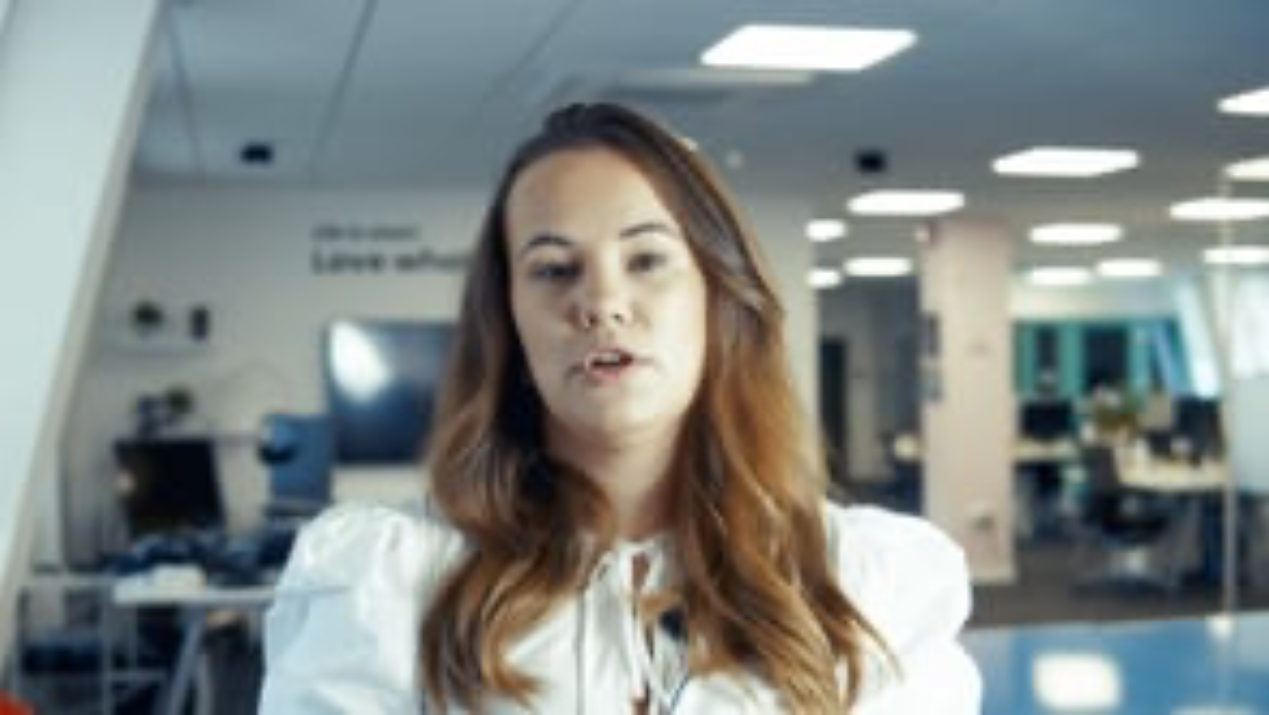

Slide 21
WHAT IS YOUR IDEA?
AFTER YOUR RESEARCH, TRY AND ARRIVE AT AN IDEA.
WHAT HAVE YOU LEARNT? USE THAT TO COME UP WITH A SOLUTION!
DOES YOUR IDEA EXCITE YOU?
IS THE IDEA ORIGINAL?
WOULD YOU USE THIS PRODUCT?
IS IT DIGITAL?
…AND DOES IT ANSWER THE BRIEF?

Slide 22
15 MINUTES REMAINING
@BIMA
@BIMA
@bima_hq_
BIMA.co.uk | #DigitalDay24

Slide 23
STEP 2: DESIGN
”Design is not just what it looks and feels like. Design is how it works”
- Steve Jobs
Notes:
Introduce the students to the second element of designing a product – Design!
You have 10 minutes to brief students and then 35 minutes for them to work on this section.

Slide 24
STEP 2: DESIGN
WHAT ARE WE LOOKING FOR?
This next part is where you bring your idea to life and help us imagine what it will look like and how it will be used. Here are a few pointers to help:
Does your client already have a strong brand, how can you incorporate their colours, logo or slogan?
What features will the product have?
Think about who’ll use this product, how can you make it simple to use?
What technology will you be using? Is it going to be on social, WhatsApp, an app or a website?
Show us how your product will be used, draw out how it will look on an app, social etc.
Where will you promote your product, how are you going to advertise?

Slide 25
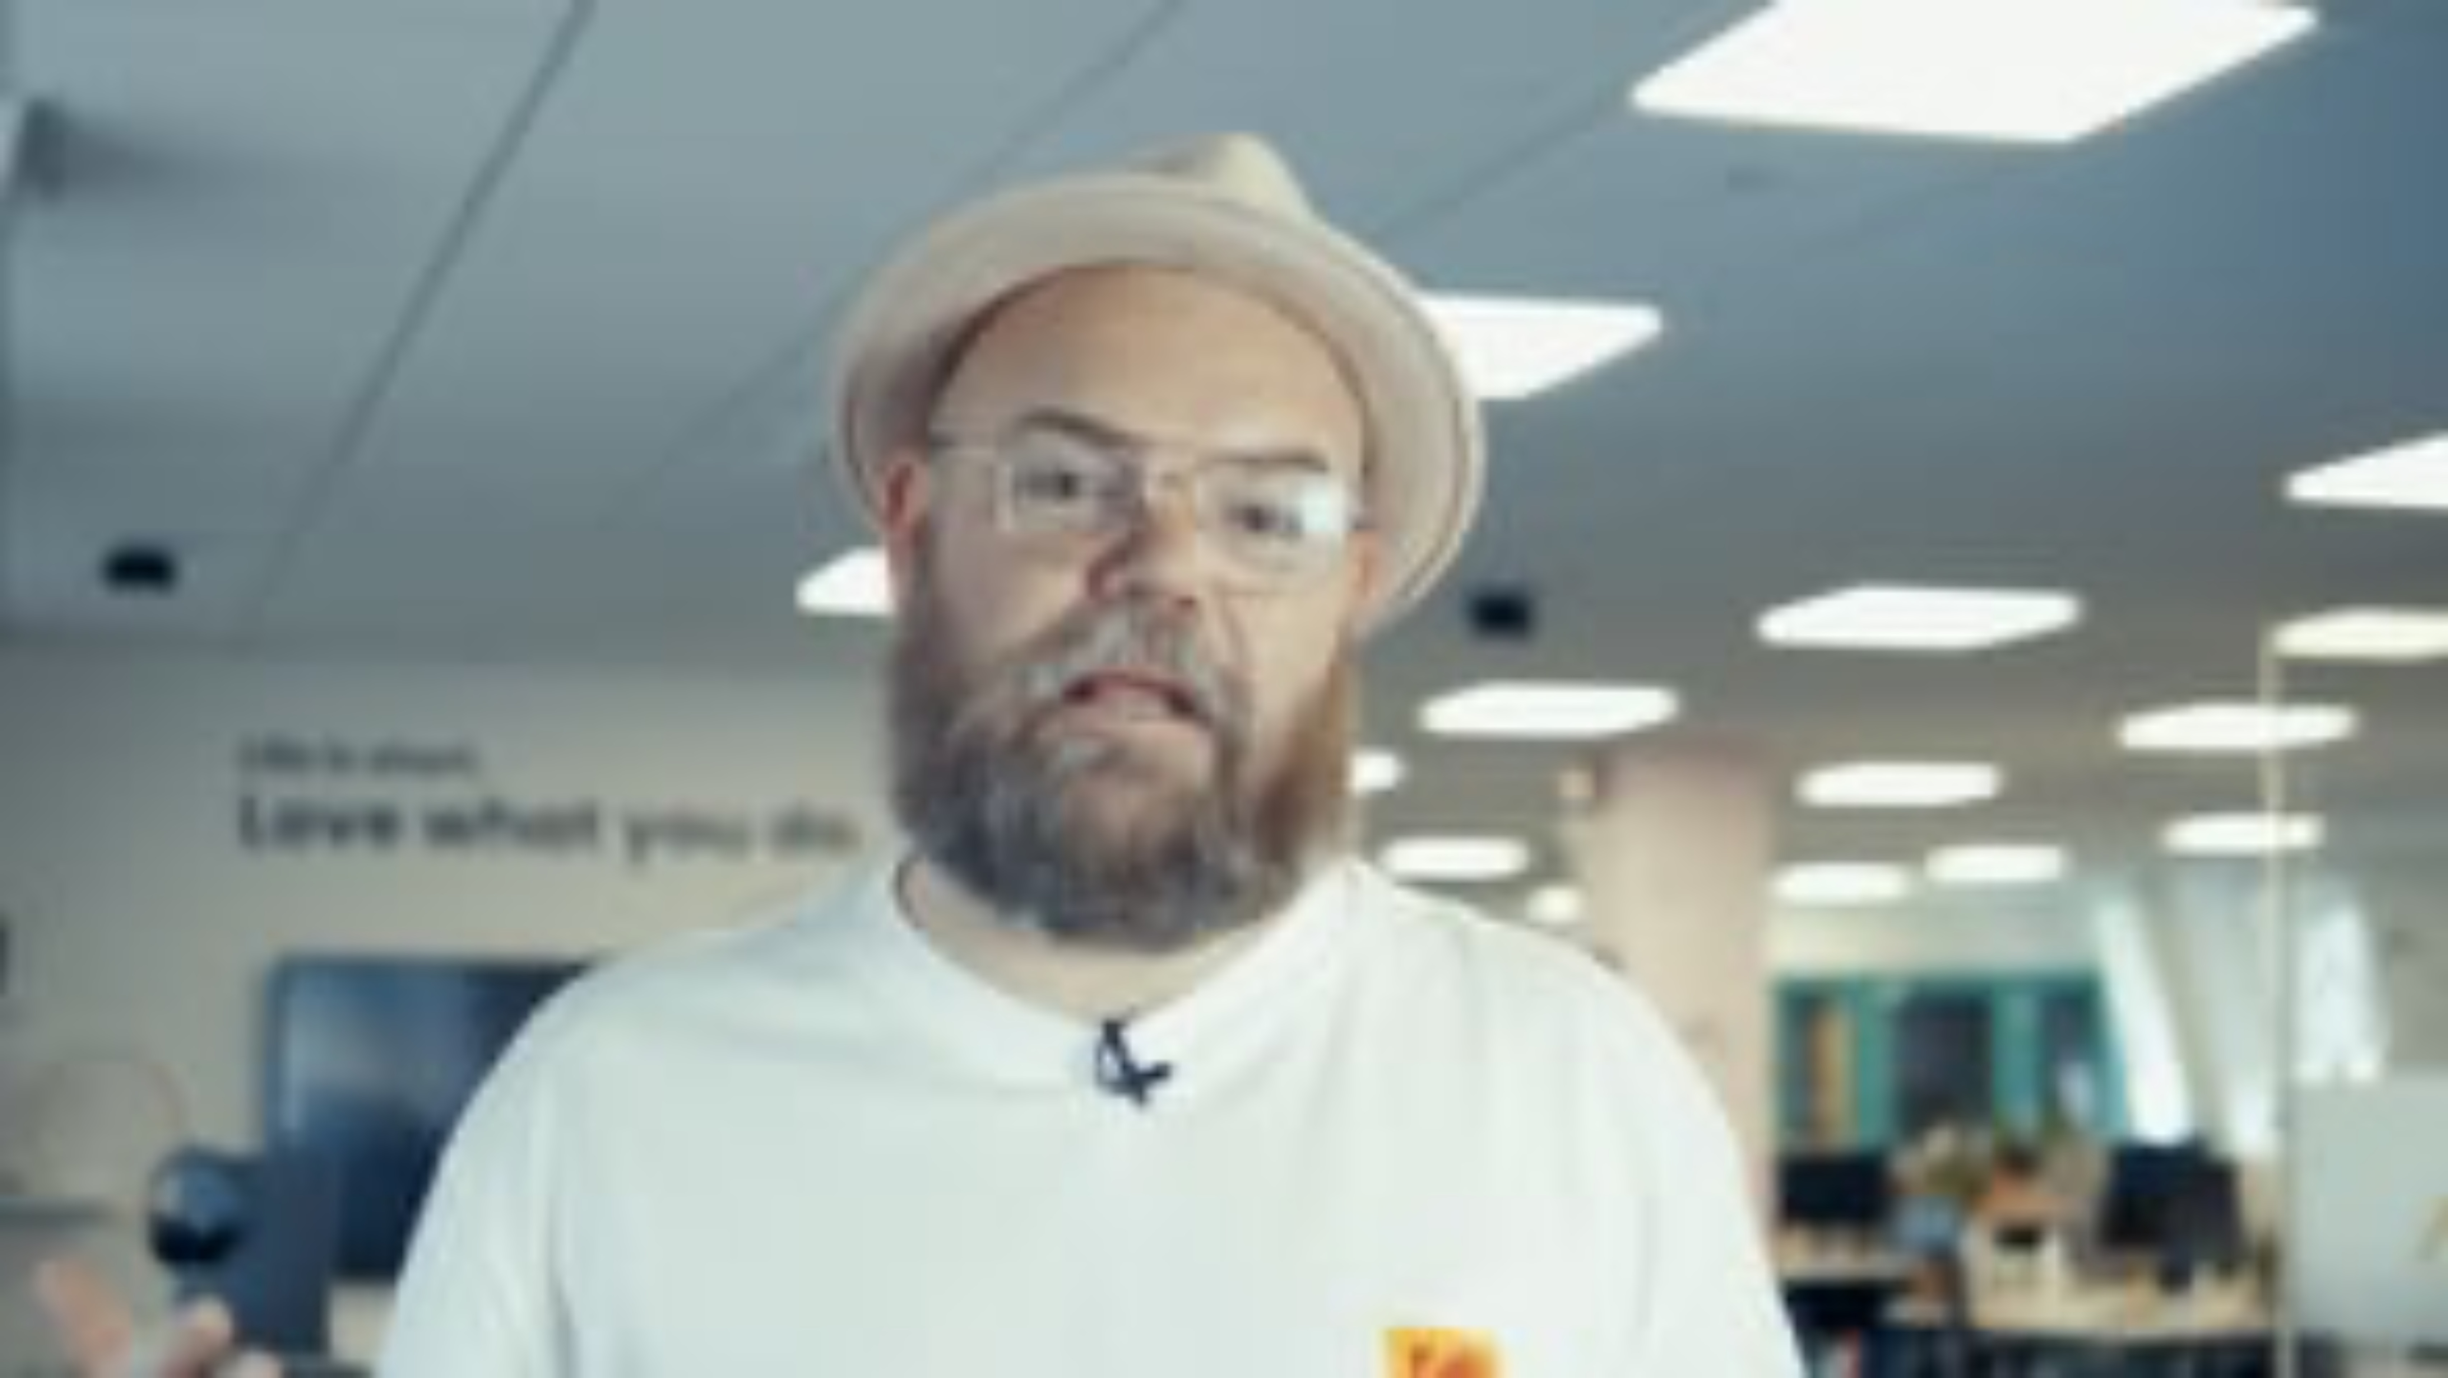

Slide 26

CHECK YOUR DESIGN
HOW DOES IT WORK?
DOES THE LOOK OF IT FEEL RIGHT FOR YOUR AUDIENCE AND CLIENT?
DOES YOUR PRODUCT SOLVE THE PROBLEM YOU IDENTIFIED?
IS IT UNIQUE?

Slide 27
15 MINUTES REMAINING
@BIMA
@BIMA
@bima_hq_
BIMA.co.uk | #DigitalDay24

Slide 28
TIME FOR
LUNCH
@BIMA
@BIMA
@bima_hq_
BIMA.co.uk | #DigitalDay24

Slide 29
RECAP…
YOU HAVE 15 MINUTES LEFT TO FINISH YOUR DESIGN.
BEFORE YOU BEGIN, SPEND 5 MINUTES AS A TEAM REVISITING THE TOP 3 THINGS YOU HAVE LEARNT IN DISCOVERY AND CONSIDER WHERE YOU ARE IN THE DESIGN PROCESS.
WITH 15 MINUTES LEFT, WHAT SHOULD YOU PRIORITISE?

Slide 30

STEP 3: DELIVER
Are you ready to pitch your idea?
Notes:
Introduce the students to the third part of the challenge – Deliver!
You have 10 minutes to brief students and then 35 minutes for them to work on this section.
Remember to give them a 15 minute warning at the end to make sure they're ready.

Slide 31
STEP 3: DELIVER
WHAT ARE WE LOOKING FOR?
It’s the final stage and time to prepare for your pitch. Here are a few tips and things to think about to help deliver the perfect pitch:
Remember you’ve only got 5 minutes max to present so make it short and sharp!
Choose who will present
Focus on what makes your product unique
What benefit or value would your idea bring to the people who buy it?
How will your product make the company money?
Explain your idea in simple terms so it’s easy to understand
Could you use anything to help explain your product?
Relax, breathe and most of all - enjoy!

Slide 32
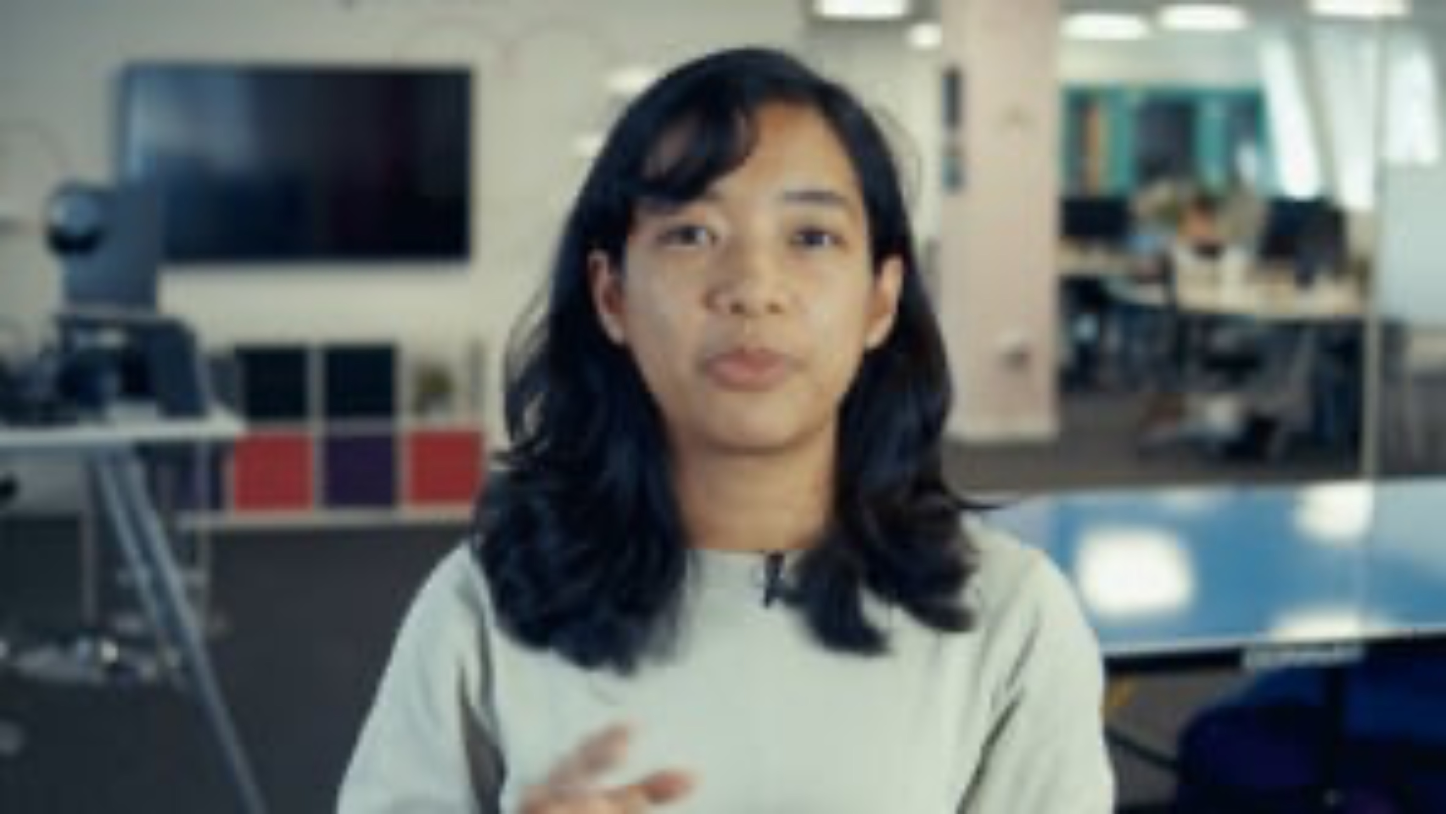

Slide 33
PITCH CHECKLIST
DOES EVERYONE HAVE SOMETHING TO DO/SAY AS PART OF YOUR PRESENTATION?
DO YOU SOUND ENTHUSIASTIC ABOUT YOUR IDEA?
DO YOU KNOW YOUR PRODUCT REALLY WELL?

Slide 34
15 MINUTES REMAINING
@BIMA
@BIMA
@bima_hq_
BIMA.co.uk | #DigitalDay24

Slide 35
TIME TO PRESENT
GOOD LUCK!
@BIMA
@BIMA
@bima_hq_
BIMA.co.uk | #DigitalDay24

Slide 36
13th November 2024
In partnership with
And thanks to
@BIMA
@BIMA
@bima_hq_
BIMA.co.uk | #DigitalDay24

